Slide 1
Sprint 5

Slide 2
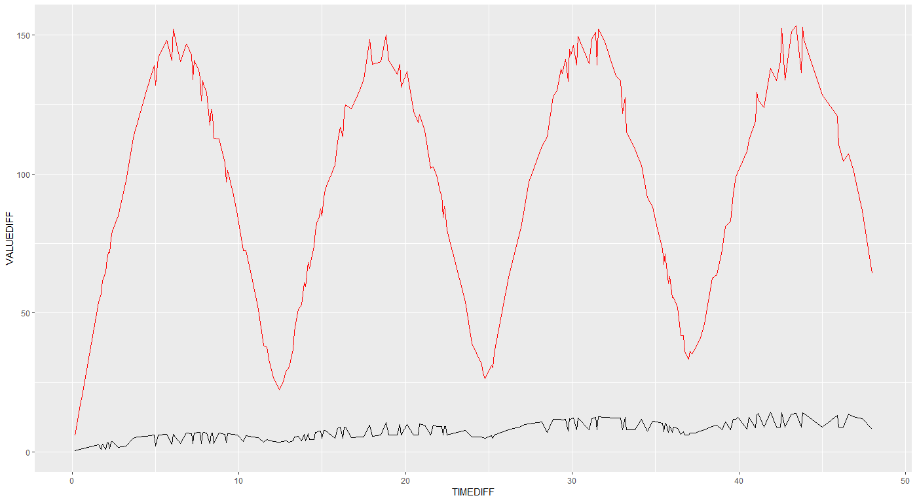

Slide 3
Why not subsample intervals?
In case of very large intervals (e.g. month): only a few samples
Subsampling:
Intuitively: not how a real logger works.
Independence assumption: does not work in case of subsampling.

Slide 4
Nice thing about this method is that it don't require equidistant time differences (because our apriori knowledge)
E.g.: you measure each 5 min, and then suddenly you don’t measure for 2 days. Suddenly you have a level shift. How likely is this level shift, given apriori data?

Slide 5
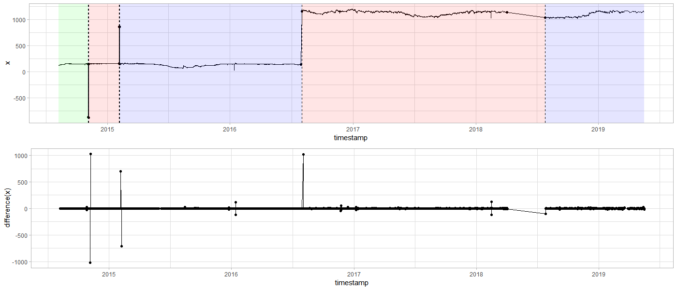
DYLP023A_S3804
Notes:
Levelshifts voorbeelden.

Slide 6
DYLP023A_S3804
tsdiff lower.bound upper.bound mu sigma2 n.dens c
1: 60 -1.570154 1.920188 0.0028163680 0.2249896 1740 5.131617
2: 3600 -41.500000 75.950000 0.0007904937 176.5041630 42216 5.533473
3: 7200 -79.300000 119.400000 -0.0027705359 624.2812076 21099 3.934556
4: 10800 -114.800000 149.900000 0.0012843477 1201.9183258 14062 5.319899
5: 14340 -135.800000 172.500000 -0.0113069111 1776.2416541 10539 3.480756
6: 14400 -135.800000 172.500000 -0.0113069111 1776.2416541 10539 4.916277
7: 18000 -160.700000 183.200000 -0.0116379456 2209.1637351 8431 3.480756
8: 21600 -172.900000 182.642000 0.0178145161 2415.4158909 7022 4.928644
9: 28800 -175.350000 150.500000 0.0536567608 1978.0713512 5263 3.662228
10: 43200 -52.909000 57.575000 0.0728922136 92.0281735 3502 4.326421
11: 64800 -174.100000 185.967000 0.1895978406 2391.7663740 2331 3.934556
12: 79200 -126.583000 112.408000 0.1101327626 1151.9654904 1902 3.480756
13: 86400 -88.000000 66.100000 0.1127067962 232.2502910 1741 4.403723
14: 129600 -89.075000 80.616000 0.2844741379 401.5038693 1160 3.480756
15: 140400 -87.033000 117.192000 0.0360796626 674.4104766 1067 3.480756
16: 151200 -152.250000 201.075000 0.0961515152 2248.8092710 990 3.480756
17: 172800 -102.700000 95.900000 0.3474837963 634.1676031 864 3.480756
18: 194400 -154.816000 205.508000 0.0083007813 2088.9459283 768 3.480756
19: 259200 -138.425000 144.800000 0.2899842105 1107.9036127 570 3.662228
20: 320400 -121.500000 125.359000 0.2672056277 972.7287087 462 3.480756
21: 324000 -131.716000 141.517000 0.0477577093 1334.0424222 454 3.480756
22: 406800 -124.500000 86.333000 0.1733130194 596.4732466 361 3.480756
23: 604800 -176.750000 186.958000 1.2400677966 2365.6598563 236 3.480756
24: 864000 -150.200000 131.500000 2.0432787879 2330.1821575 165 3.480756
25: 9882000 -52.900000 23.000000 0.0250000000 1269.8025000 4 3.480756
tsdiff lower.bound upper.bound mu sigma2 n.dens c

Slide 7
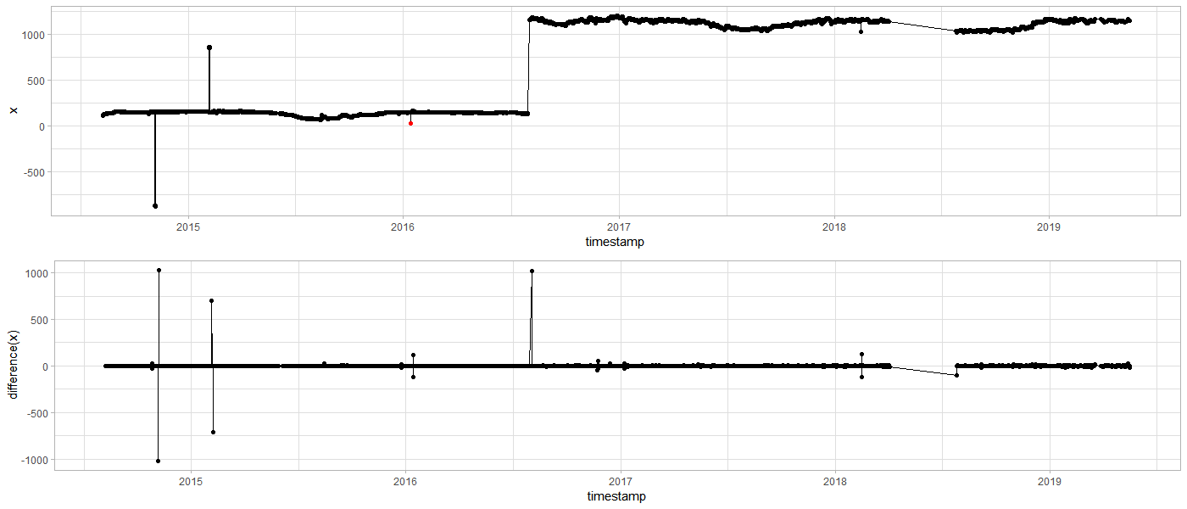
DYLP023A_S3804
Notes:
Ene outlier werd gedetecteerd, maar andere niet. Reden zit in time differences.

Slide 8
DYLP023A_S3804
tsdiff vdiff lower.bound upper.bound mu sigma2 n.dens c outlier
3600 -119.1260886 -41.5 75.9 0.000790494 176.504 42216 5.533473 TRUE
3600 118.8260229 -41.5 75.9 0.000790494 176.504 42216 5.533473 TRUE
14400 -116.9593409 -135.8 172.5 -0.011306911 1776.242 10539 4.916277 FALSE
10800 122.2678611 -114.8 149.9 0.001284348 1201.918 14062 5.319899 FALSE
Notes:
Hier is te zien dat er bij de eerste timediff 1u is, terwijl bij 2e om een langere periode gaat.

Slide 10
Sprint 4
Documentation and diagnostic plots

Slide 11
Agenda
Documentation
Diagnostic plots (outliers)
Air pressure: clean a-priori data
Universal data loading
Geotech data
Comparison outlier detection: v0.04 vs. tsoutliers
Next steps

Slide 12
Documentation
Vignette

Slide 13
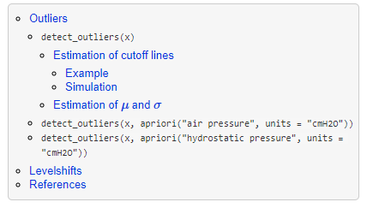
Documentation
Vignette TOC
2 main parts:
Vignette
API interface
Goal: pkgdown-like documentation
Website-like documentation
Supported by github

Slide 14
Diagnostic plots
Outliers

Slide 15
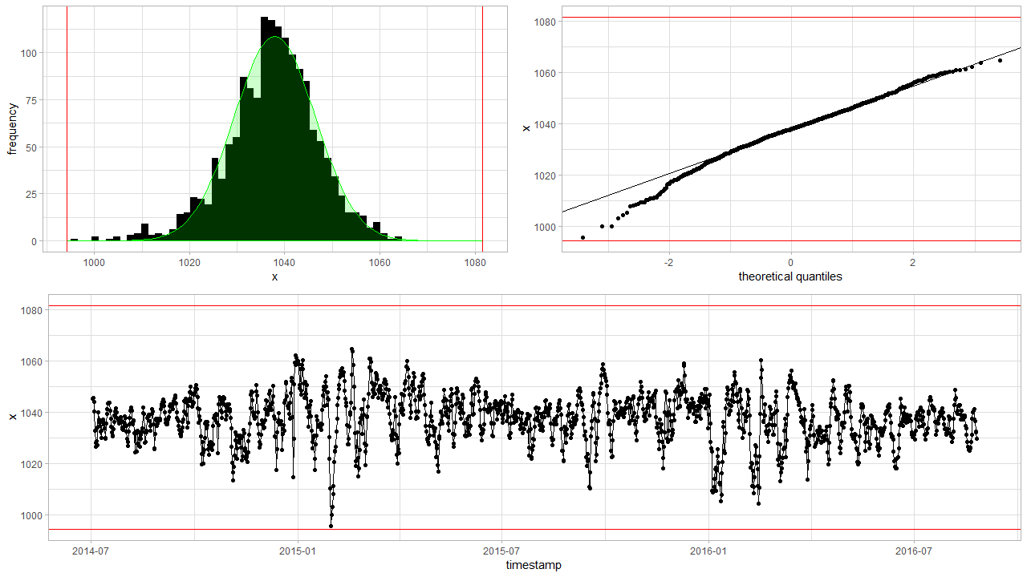
Diagnostic plots detect_outliers(x, plot = TRUE)

Slide 16
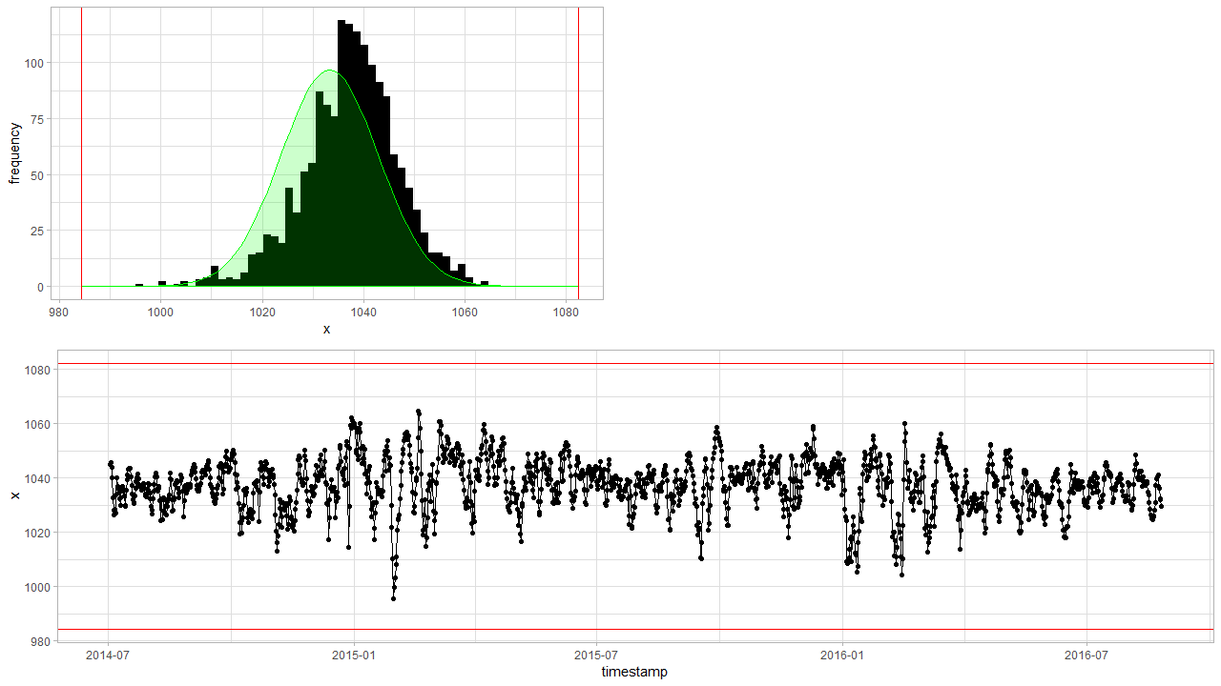
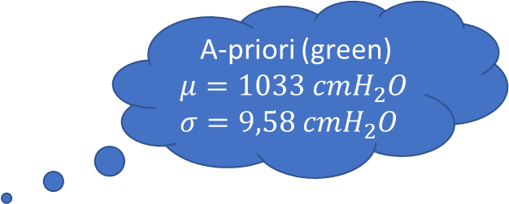
Diagnostic plots detect_outliers(x, apriori(“air pressure”) , plot = TRUE)
A-priori (green)
$$μ=1033 cmH_{2}O$$
$$σ=9,58 cmH_{2}O$$
Notes:
Based on new data

Slide 17
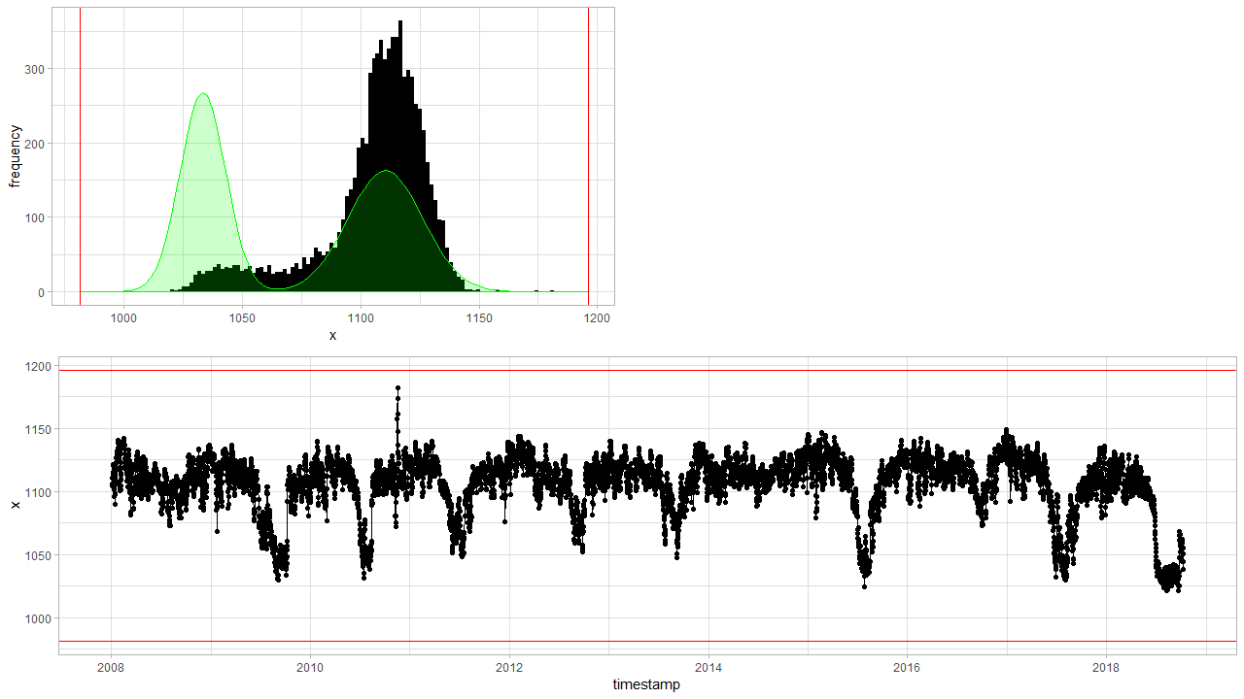
Diagnostic plots detect_outliers(x, apriori(“hydrostatic pressure”) , plot = TRUE)
Notes:
Based on new data

Slide 18
Air pressure
Clean a-priori data

Slide 19
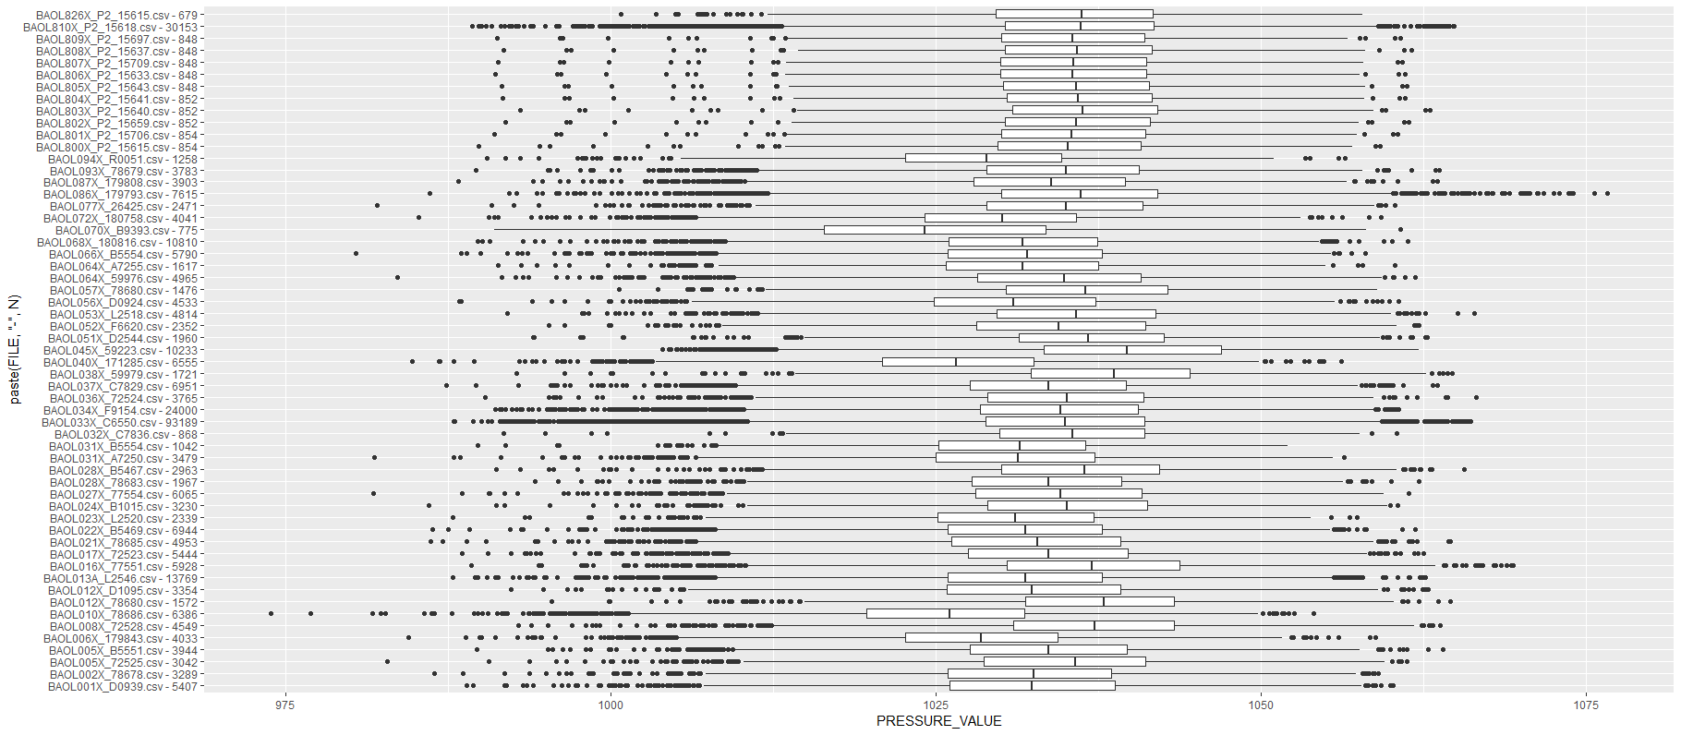
Air pressure: clean a-priori data
Notes:
Aggregated by day --> Some data is is high frequency (like BAOL033X) which has 20x or more datapoints than others, and thus has a higher weight on the distribution.
Are BAOL040X and BAOL010X and BAOL094X from the same region? And BAOL070X? This latter might be amplifying the left skewness.
Only data with a timestamp is taken into consideration.

Slide 20
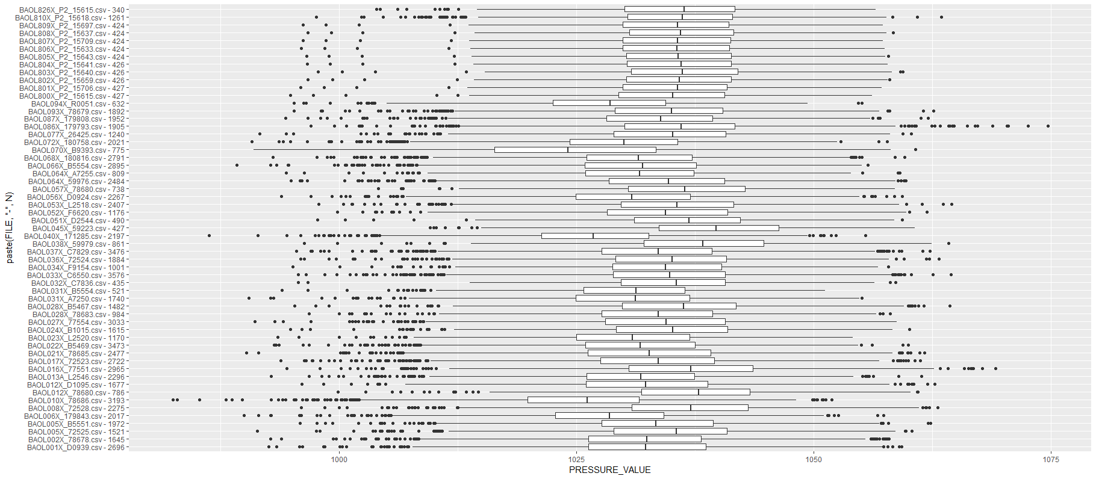
Air pressure: aggregated clean a-priori data

Slide 21
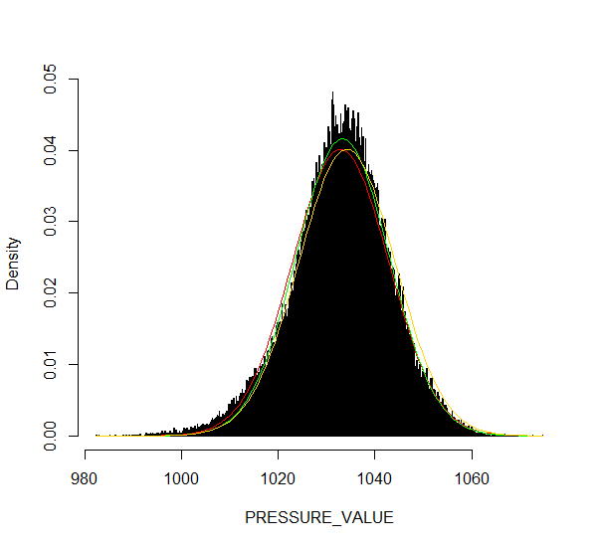
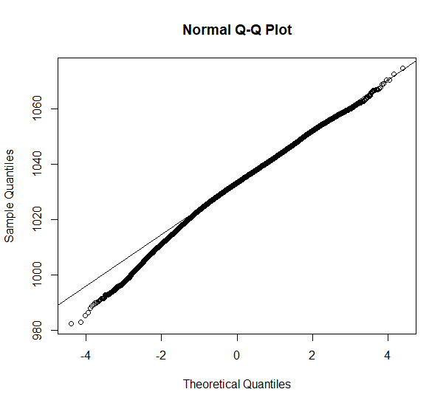
Comparison: apriori air pressure red (sd/mean), green (robust), yellow (robust old data)
A-priori pressure data is as good as it can get…
Notes:
The green curve s the robust estimate for in v0.02 (mean = 1033.317 // sd = 9.586297). The yellow one is the old estimate (1034.2 // 9.93342).

Slide 22
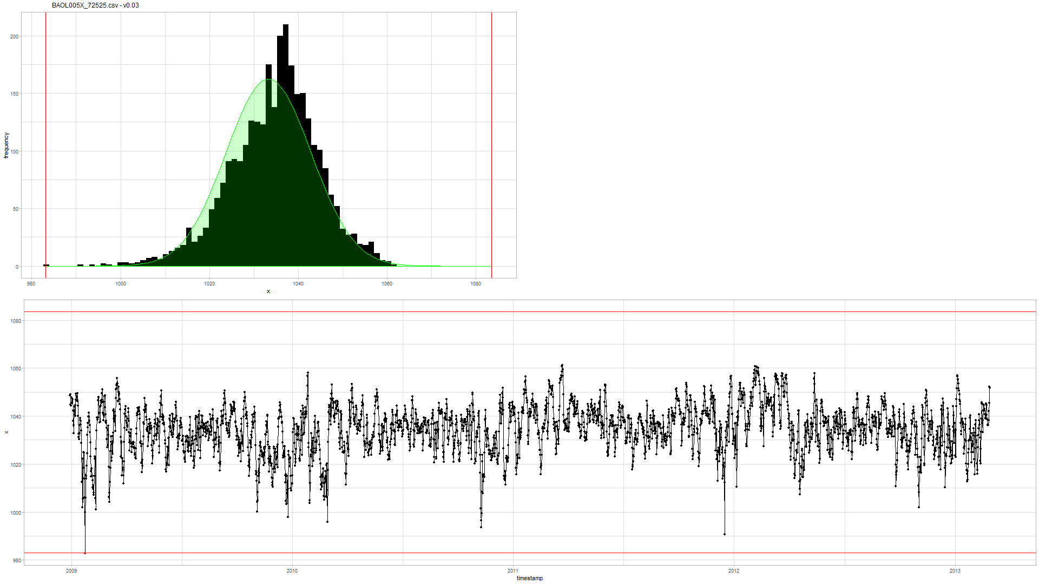

Example (BAOL005X_72525) v0.03 (new) vs. v0.02 (old)
Notes:
Rechts: oude v0.02: eerste punt is geen outlier
Links: nieuwe v0.03: is outlier

Slide 23
Logger
Universal data loading

Slide 24
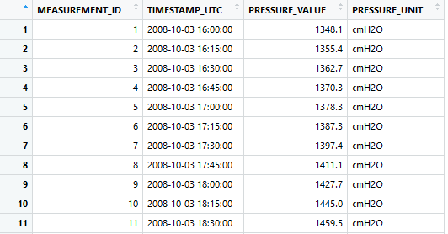
Uniform data loading: Logger object
Todo… VMM.
Static methods:
Logger::enumerate(partner = 'inbo')
Logger::enumerate(partner = 'geotech’)
Initialization:
df <- Logger('DYLP006X')$df
df <- Logger('ff_b29d_0903')$df
Uniform dataframe:
Primary key: MEASUREMENT_ID
UTC timestamp: TIMESTAMP_UTC
Value: PRESSURE_VALUE
Units: PRESSURE_UNIT
Notes:
Bedoeling is dat hier ook VMM data op een gelijkaardige manier wordt geladen.

Slide 25
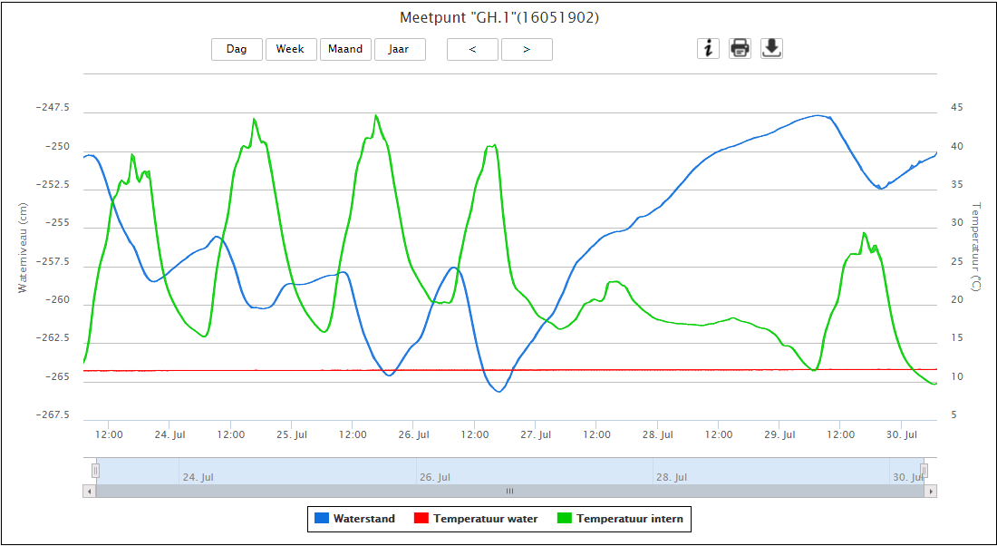
VMM raw data?
http://www.ellitrack.nl/tracker/

Slide 26
Geotechniek
Outliers

Slide 27
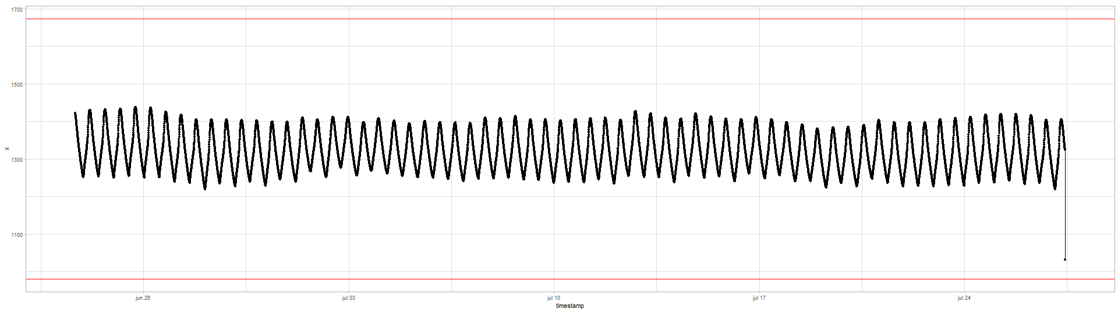
Quick exploration
All data have timestamps without NA
Time intervals are either 5 or 15min:
5 min 15 min 1307676 436567
If necessary: best to aggregate on hourly basis?
The data is clearly seasonal and a random walk

Slide 28
Geotech outlier comparison
Main comparison file:
https://github.com/DOV-Vlaanderen/groundwater-logger-validation/blob/levelshifts/src/r/outliers/outliers_comparison_geotech.pdf
5 methods
v0.01: normality assumption
v0.02: upper level = apriori air pressure, lower level normality assumption
v0.04: based on apriori difference min(left-diff, right-diff) knowledge:
5min: max 10cmH2O
tsoutliers:
Full: AO, TC, LS
AO only highlights with difference plot

Slide 29
tsoutliers --> AO
v0.01
v0.02
v0.04
tsoutliers --> AO, TC, LS

Slide 30
Geotech outlier comparison: v0.01
Data not normal but a seasonal random walk.

Slide 31
Geotech outlier comparison: v0.01
Sometimes it works, but mostly not…

Slide 32
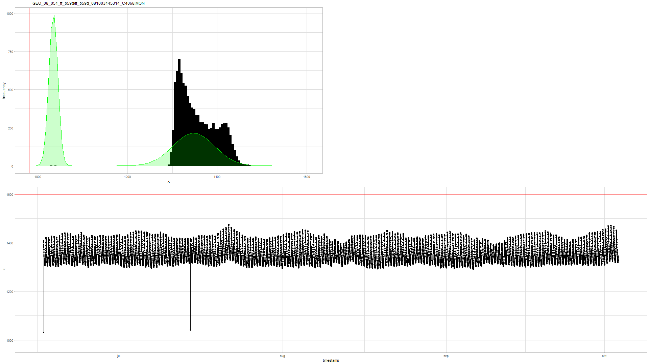
Geotech outlier comparison: v0.02
Similar to v0.01…

Slide 33
Geotech outlier comparison: v0.02
In the air…
“valid data”
Notes:
Voordeel is dus dat je gemakkelijk kan zien of de data wel “valid is” … maar daar stopt het wel.

Slide 34
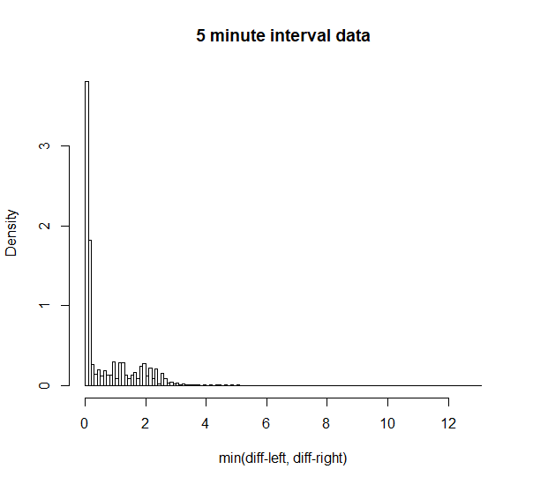
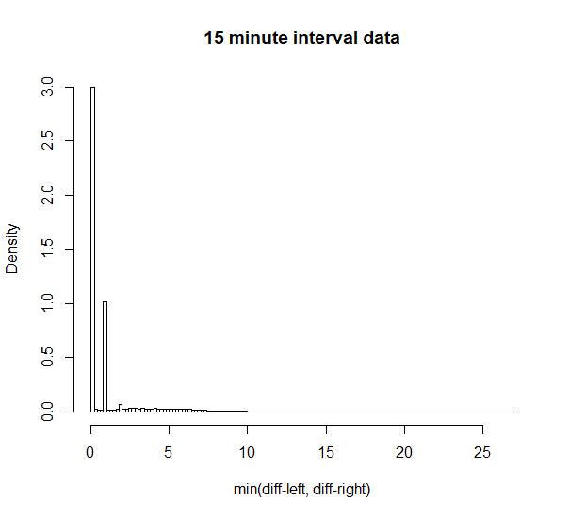
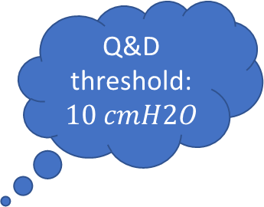

Geotech outlier comparison: v0.04
Q&D threshold: $10 cmH2O$
Q&D threshold: $30 cmH2O$
Notes:
Treshold: 10 and 30 cmH2O

Slide 35
Geotech outlier comparison: v0.04
Detected… (cf. v0.01 not detected)

Slide 36
Geotech outlier comparison: v0.04
Detected… (cf. v0.01 not detected)

Slide 37
Geotech outlier comparison: v0.04
Detected… (cf. tsoutliers not detected due to aggregation)

Slide 38
Geotech outlier comparison: v0.04
Detected… (cf. tsoutliers not detected due to last point or agg.)

Slide 39
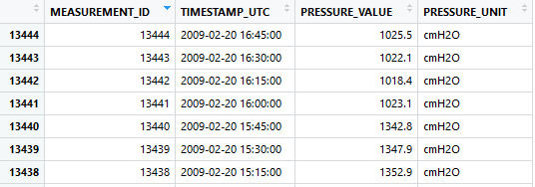
Geotech outlier comparison: v0.04
Missed due to multiple points. Level shift?

Slide 40
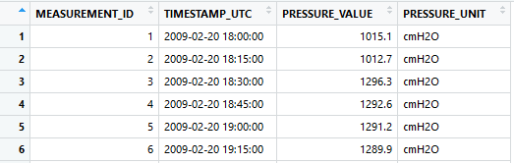
Geotech outlier comparison: v0.04
Also missed.
Level shift?

Slide 41
Geotech outlier comparison: tsoutliers
tsoutliers found it. Wrong point??

Slide 42
Geotech outlier comparison: tsoutliers
Weird… (v0.04 detects nothing)

Slide 43
tsoutliers detects two outliers? v0.04 nothing

Slide 44
Only v0.04 detected…

Slide 45
tsoutliers detects level shifts also…

Slide 46
tsoutliers aggregates: how to extract 1 single point.
Notes:
Omwille van aggregatie op uur ziet de tsoutlier plot er lichtjes anders uit.

Slide 47
Geotech outlier comparison: conclusion
v0.01 and v0.02
Normality assumption doesn’t apply to hydrostatic pressure.
v0.02 could be used to assess validity of data.
tsoutliers
Sometimes detects weird AO’s due to auto.arima model.
Slow: +10h on pp09-2_120829131517_F8511, pp08-2_120829135933_F8503, ff_b51d_090429160102_C4089
Aggregation required --> makes outlier detection and extraction of 1 point difficult.
Biggest strength is LS detection.
Personal note: we should be able to make something better.
v0.04
Is intelligible and fast.
Has no problems with first point and last point being outliers.
Is good in detecting 1 point outliers.
Has problems with > 1 point sequential outliers --> level shift?
Has best potential for outlier detection?

Slide 48
Level shifts: summary
Suggestion:
Reference algorithm (for comparison): tsoutliers
A custom approach…

Slide 49
Level shift?
Notes:
Omwille van aggregatie op uur ziet de tsoutlier plot er lichtjes anders uit.

Slide 50
No level shift?
Notes:
Omwille van aggregatie op uur ziet de tsoutlier plot er lichtjes anders uit.

Slide 51
Multiple level shifts?

Slide 52
Clear level shift.

Slide 53
Clear short level shift and outlier.

Slide 54
Next steps

Slide 55
Next steps
VMM data?
Focus on intelligible models vs. tsoutliers?
In case of outlier detection: you know “why”.
Improve and implement v0.04?
Level shifts
Improve tsoutliers (i.e. detect only large level shifts)
Make diagnostic plots for level shifts.
Custom approach…?

Slide 56
The End

Slide 57
Sprint 3
Level shifts

Slide 58
Agenda
Outliers
Level shifts
strucchange package
tsoutliers package
rank-based shift detection
Timestamps
Data aggregation
gwloggeR v0.1.2

Slide 59
Outliers
Recap

Slide 60
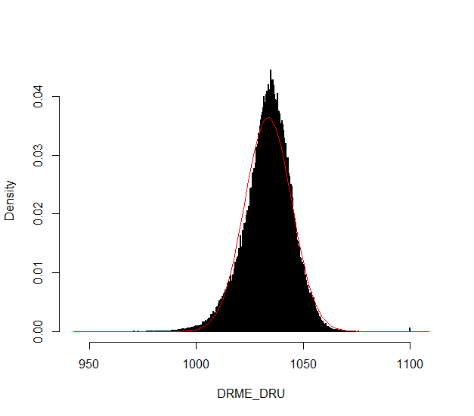
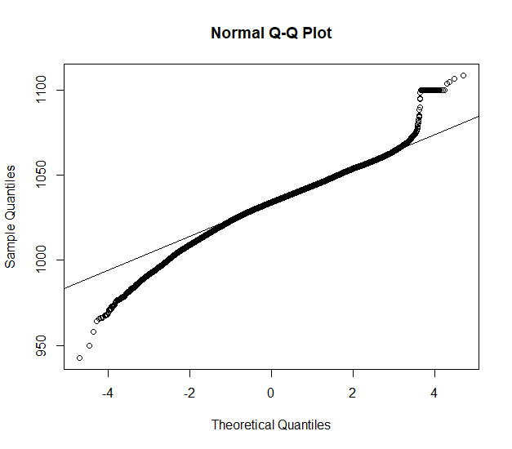
Outliers: v0.02
Validation
Excluded: BAOL089|BAOL079|BAOL006 (mBar)
Range: 800 < x < 1200
Notes:
Excluded: BAOL089|BAOL079|BAOL006
Range: 800 < x < 1200

Slide 61
Outliers: v0.02 example detect_outliers(x, apriori("air pressure", "cmH2O"))

Slide 62
Outliers: v0.02
Next steps
Build kernel based on clean data
Simulation test: verify power
Document in detail
Notes:
Excluded: BAOL089|BAOL079|BAOL006
Range: 800 < x < 1200

Slide 63
Level Shifts
strucchange
tsoutliers
rank-based

Slide 64
strucchange package
For modeling changes in mean

Slide 65
Level shift?

Slide 66
Strucchange package

Slide 67
Strucchange package
Pros:
Detects changes in a linear model (e.g. intercept only linear regression)
Mature package
Speed: 5 min average
Cons:
No ARIMA support
Uses lots of memory (+5GB on some cases)

Slide 68
tsoutliers package
For modeling level shifts with ARIMA models

Slide 69
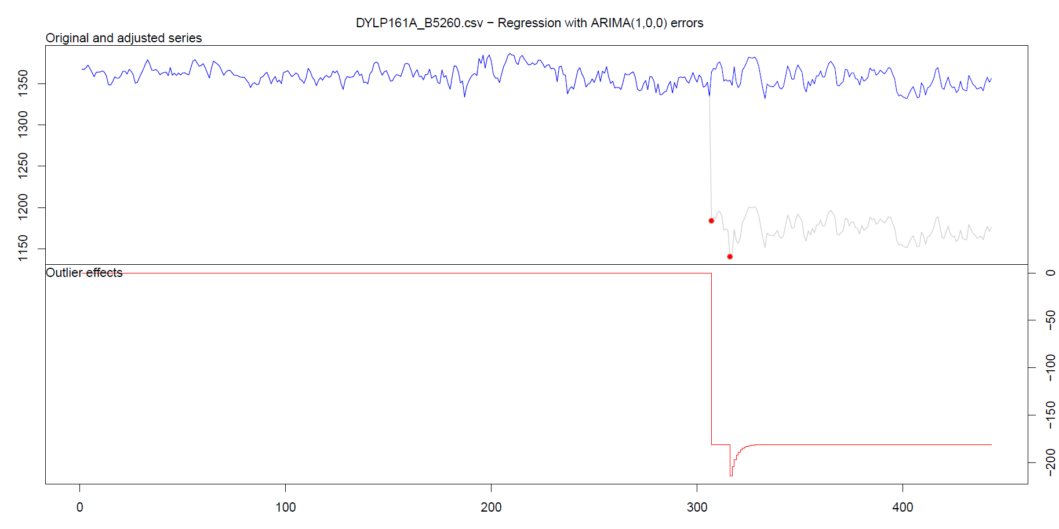
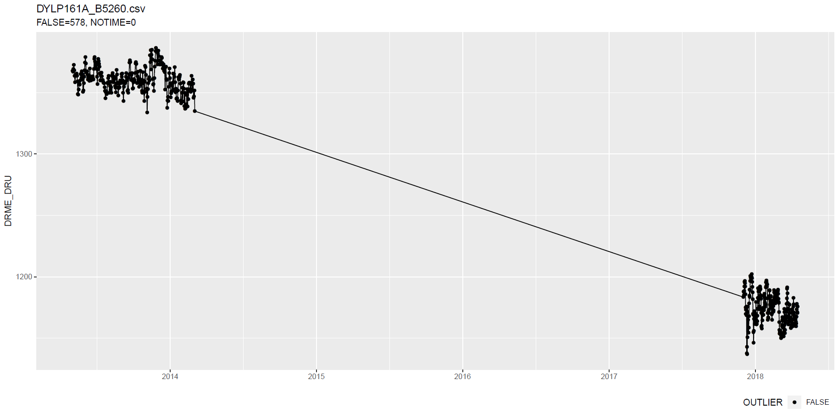
tsoutliers package
Notes:
Wat hier ook kan zijn, is dat intussentijd de situatie gewoon geleidelijk is gewijzigd: dus niet abrupt.

Slide 70
tsoutliers package
Notes:
Wat hier ook kan zijn, is dat intussentijd de situatie gewoon geleidelijk is gewijzigd: dus niet abrupt.

Slide 71
tsoutliers package
Notes:
Wat hier ook kan zijn, is dat intussentijd de situatie gewoon geleidelijk is gewijzigd: dus niet abrupt.

Slide 72
tsoutliers package
More cases: see here.

Slide 73
tsoutliers package
Pros:
Allows for a wide range of ARIMA-based models
Seems to detect LS well
Speed: 10 min average with aggregation
Cons:
Can not be used without aggregation (for >5k points)
Package is still in development

Slide 74
Rank-based shift detection
For modeling level shifts with rank-based statistics

Slide 75
Rank based level shift detection
Fried, R. e.a., On rank tests for shift detection in time series, 2007
Bovik, A.C. e.a., Nonparametric Tests for Edge Detection in Noise, 1986
Based on the distribution of a test statistic (e.g. Wilcoxon statistic) the normal situation can be defined. Based on this definition, exceptional shift situations could be detected.
Pro: speed!

Slide 76
Defining Level Shift
Discussion

Slide 77
Level shift?

Slide 78
Level shift?
Notes:
Lots of missing data!!

Slide 79
Level shift?
Notes:
Lots of missing data!!

Slide 80
Level shift?

Slide 81
Level shift?

Slide 82
Level shift?
Notes:
2 shifts?

Slide 83
Level shift?
Notes:
Is rood een flat line?

Slide 84
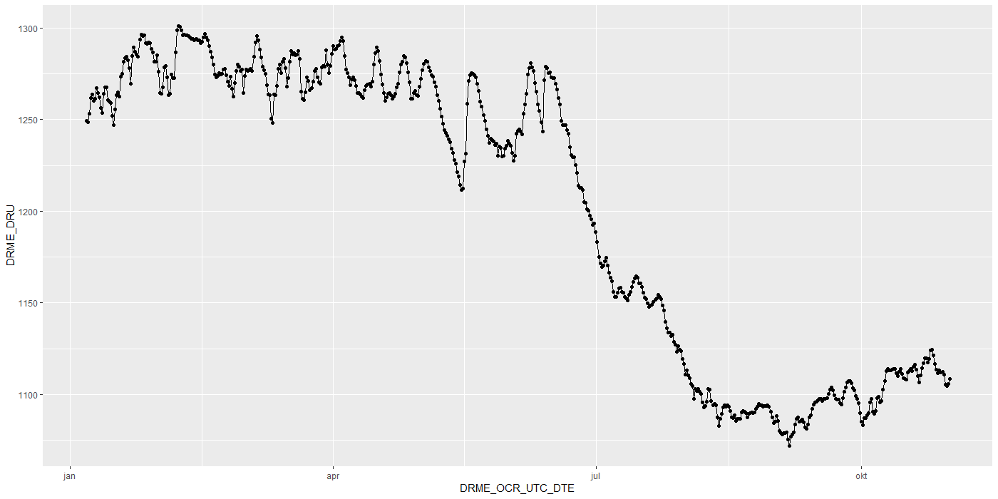
Level shift?

Slide 85
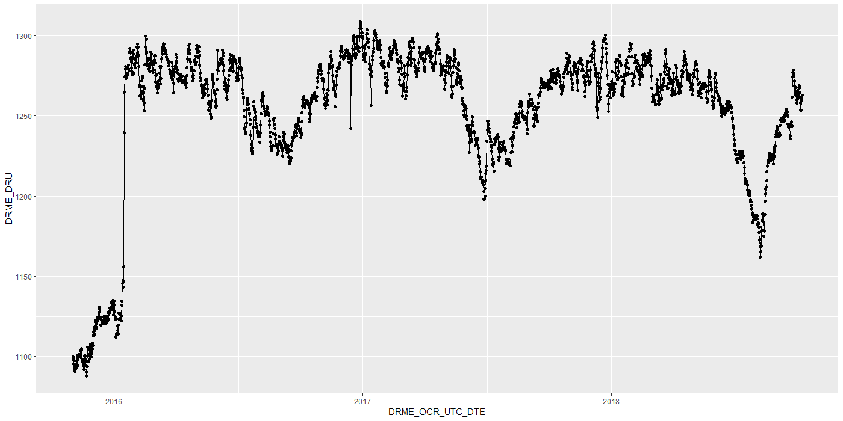
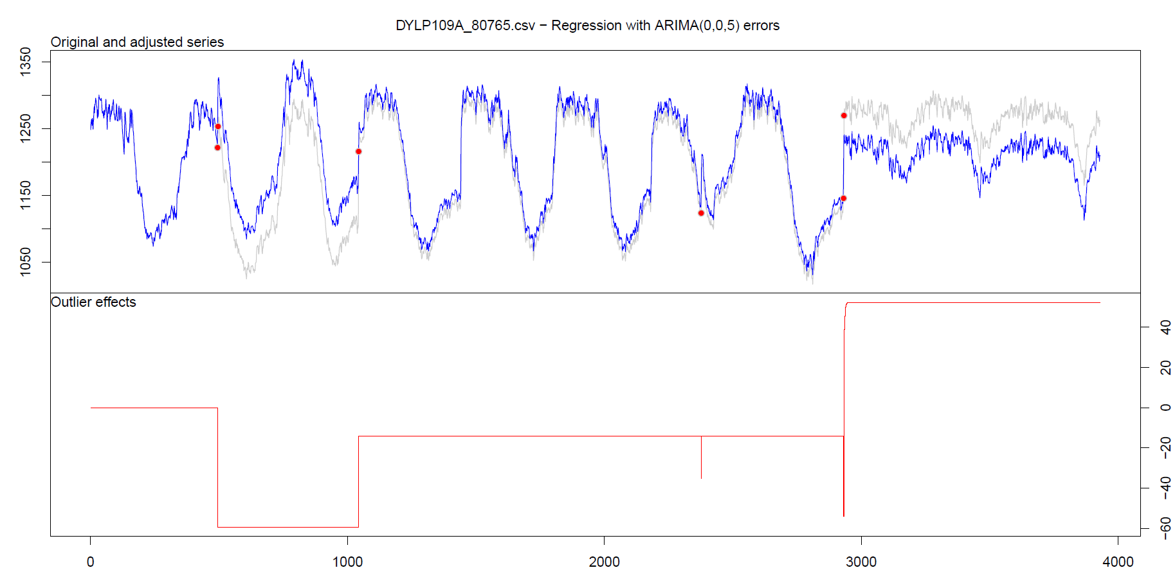
Level shift?

Slide 86
Level shift?

Slide 87
Level shift: tsoutliers

Slide 88
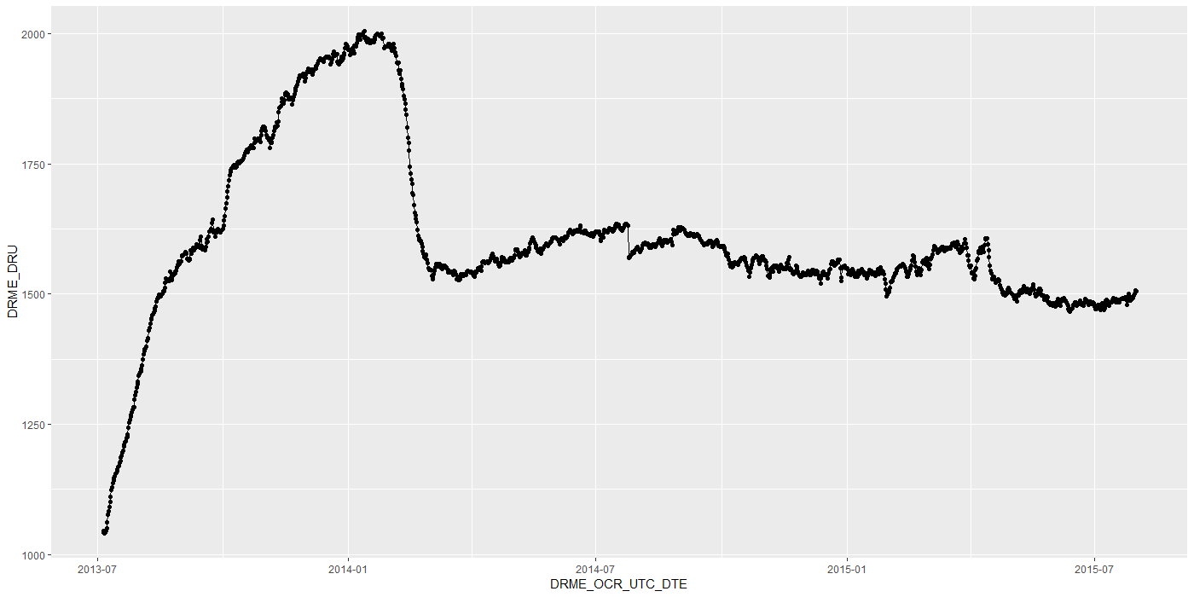
Level shift?
Notes:
Is rood een flat line?

Slide 89
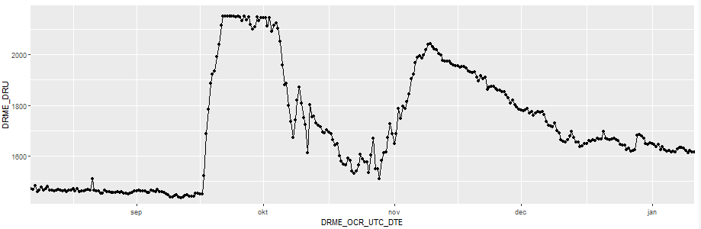
Level shift?
?
Notes:
Is rood een flat line?

Slide 90
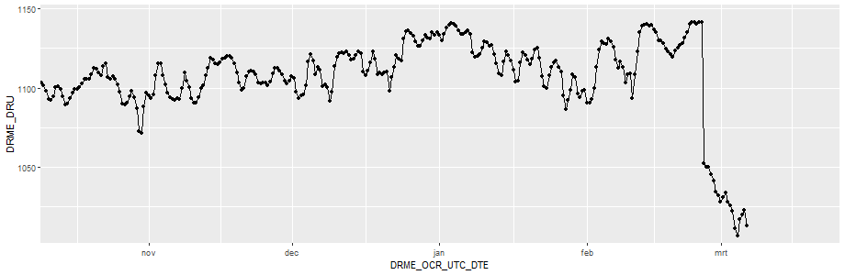
Level shift?
Notes:
Is rood een flat line?

Slide 91
Timestamps

Slide 92
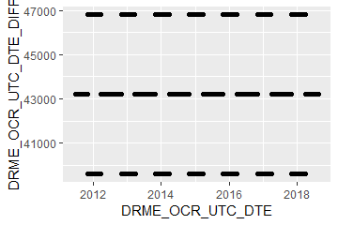
Timestamps: varying time-difference between observations (BAOL068X_180816.csv)
Sometimes 11, 12 or 13 hours
Notes:
BAOL068X_180816.csv

Slide 93
Timestamps: varying time-difference between observations
Equidistant observations are important for ARIMA-like timeseries models.
Without equidistance, the usability of ARIMA is limited.
Example: Differencing
For small time-differences: measured differences determined by sensor inaccuracy
For large time-differences: measured differences determined by sensor inaccuracy and atmospheric changes.
Timestamps: Take into account all kinds of scenarios?

Slide 94
Importance
Visualization:
Its either TIMESTAMP or SEQUENCE
INBO:
Can make sure that timestamp is always available.
Other parties?

Slide 95
gwloggeR
Change log
Feedback?

Slide 96
Change log
“Diver” → “hydrostatic pressure”
ap <- apriori("hydrostatic pressure", "cmH2O")
detect_outliers(x, apriori = ap)
detect_duplicates(ts)

Slide 97
Aggregation function
Lump together and take average.
Other (better?) ways?

Slide 98
Next steps

Slide 99
Next steps
Outliers v0.02
Build kernel based on clean data
Simulation test: verify power
Document in detail
Level shifts:
Gather more Level Shift examples
Better visualization
“Nederlanders”?

Slide 100
Hysteresis?

Slide 101
The End

Slide 102
Sprint 2
Outliers

Slide 103
Agenda
DRME_DMST_CDE validation
Outliers: v0.02 update
Comparison v0.01 vs v0.02
gwloggeR v0.1.1
Assessment
anomalize
tsoutliers

Slide 104
DRME_DMST_CDE
Flags from DB: ENT (entered); DEL (deleted) and INV (invalid).

Slide 105
DRME_DMST_CDE
On all *.csv-data:
DEL ENT INV VLD <NA>
462 556271 4697 16 0

Slide 106
DRME_DMST_CDE: VLD and DEL
PPNT_ID PPNT_CDE DRSO_ID DRSO_SER_NBR DRME_ID DRME_OCR_UTC_DTE DRME_DRU DRME_TPU DRME_DMTP_CDE DRME_DMST_CDE SEQUENCE
1: 7019 BAOL001X 275 D0939 238389 2010-11-11 10:00:00 1018.100 NA LDME VLD 1093
2: 7019 BAOL001X 275 D0939 1824560 2010-11-11 10:00:00 1018.075 6.033 LDME ENT 1130
3: 7019 BAOL001X 275 D0939 238390 2010-11-11 22:00:00 1007.300 NA LDME VLD 1094
4: 7019 BAOL001X 275 D0939 1824561 2010-11-11 22:00:00 1007.275 8.163 LDME ENT 1131
5: 7019 BAOL001X 275 D0939 238391 2010-11-12 10:00:00 1015.400 NA LDME VLD 1095
6: 7019 BAOL001X 275 D0939 1824562 2010-11-12 10:00:00 1015.375 11.213 LDME ENT 1132
7: 7019 BAOL001X 275 D0939 238392 2010-11-12 22:00:00 1012.900 NA LDME VLD 1096
8: 7019 BAOL001X 275 D0939 1824563 2010-11-12 22:00:00 1012.850 12.457 LDME ENT 1133
9: 7019 BAOL001X 275 D0939 238393 2010-11-13 10:00:00 1014.600 NA LDME VLD 1097
10: 7019 BAOL001X 275 D0939 1824564 2010-11-13 10:00:00 1014.600 10.810 LDME ENT 1134
11: 7019 BAOL001X 275 D0939 238394 2010-11-13 22:00:00 1012.700 NA LDME VLD 1098
12: 7019 BAOL001X 275 D0939 1824565 2010-11-13 22:00:00 1012.675 10.953 LDME ENT 1135
Duplicates: Detect those too?
Notes:
Duplicaten in de DB?

Slide 107
DRME_DMST_CDE: INV
Validation

Slide 108
DRME_DMST_CDE: INV
Validation

Slide 109
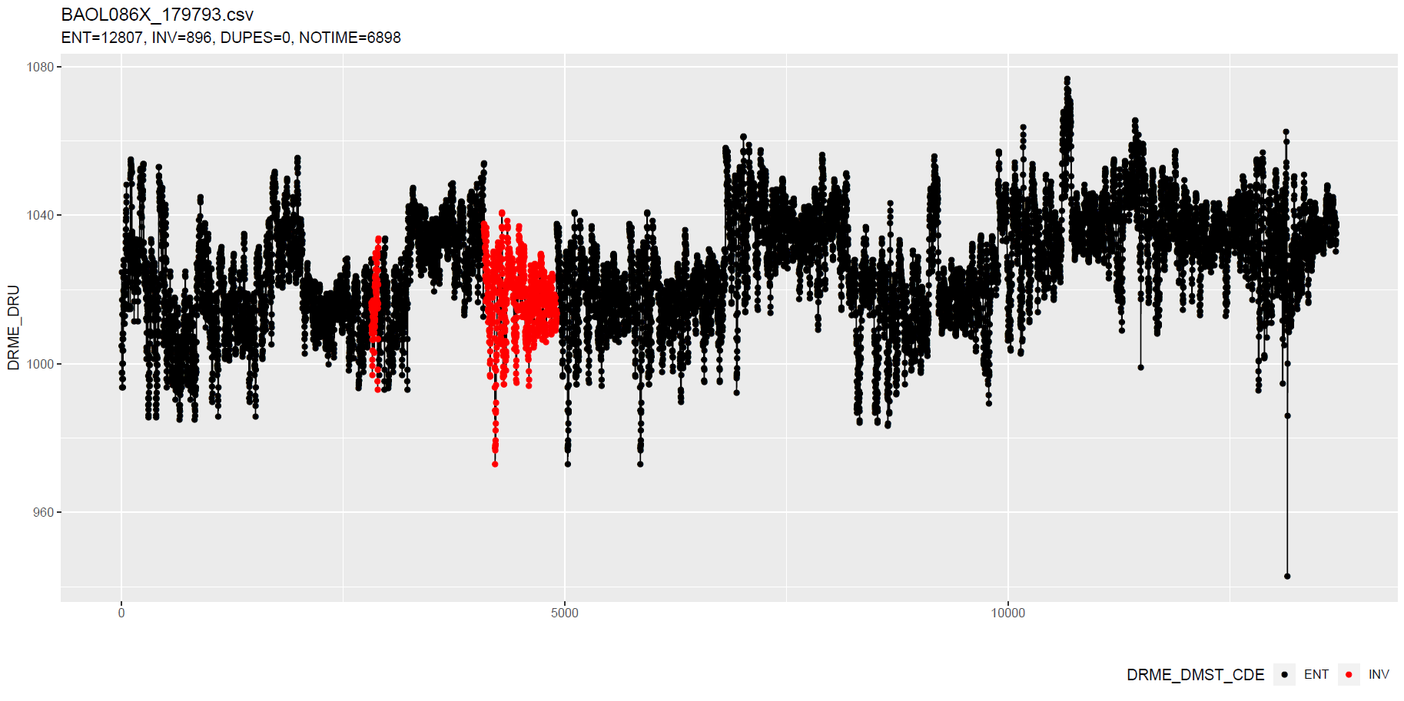
DRME_DMST_CDE: INV
Validation
No Timestamp (Inconsistent)
No Timestamp: Detect those too?
Notes:
Inconsistent because there are also black dots that have no timestamp.

Slide 110
Outliers: v0.02 update
Uses simple a-priori knowledge about air pressure, temperature, etc.

Slide 111
Outliers: v0.02 update
Validation
Excluded: BAOL089|BAOL079|BAOL006 (mBar)
Range: 800 < x < 1200
Notes:
Excluded: BAOL089|BAOL079|BAOL006
Range: 800 < x < 1200

Slide 112
Outlier comparison
v0.01, v0.02, DRME_DMST_CDE

Slide 113
Outlier comparison

Slide 114
Outlier comparison

Slide 115
Outlier comparison

Slide 116
Outlier comparison

Slide 117
Outlier comparison

Slide 118
Outlier comparison

Slide 119
Outlier comparison

Slide 120
Outlier comparison

Slide 121
tsoutliers package

Slide 122
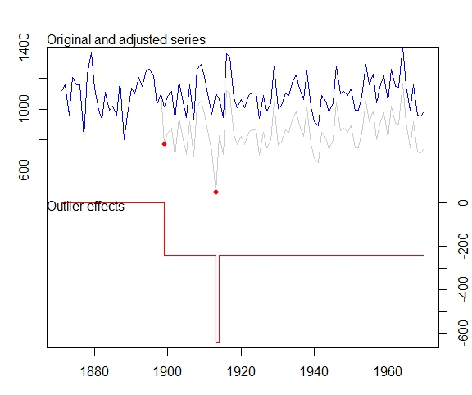
tsoutliers package
auto.arima(Nile)
Series: Nile
ARIMA(1,1,1)
Coefficients:
ar1 ma1
0.2544 -0.8741
s.e. 0.1194 0.0605
sigma^2 estimated as 19769: log likelihood=-630.63
AIC=1267.25 AICc=1267.51 BIC=1275.04
nile.outliers <- tso(Nile,types = c("AO","LS","TC"))
nile.outliers
Series: Nile
ARIMA(0,0,0) with non-zero mean
Coefficients:
intercept LS29 AO43
1097.7500 -242.2289 -399.5211
s.e. 22.6783 26.7793 120.8446
sigma^2 estimated as 14401: log likelihood=-620.65
AIC=1249.29 AICc=1249.71 BIC=1259.71
Outliers:
type ind time coefhat tstat
1 LS 29 1899 -242.2 -9.045
2 AO 43 1913 -399.5 -3.306
Notes:
https://stats.stackexchange.com/questions/104882/detecting-outliers-in-time-series-ls-ao-tc-using-tsoutliers-package-in-r-how

Slide 123
tsoutliers package: AO’s

Slide 124
tsoutliers package: AO’s

Slide 125
tsoutliers package: AO’s
WRONG
TIMESTAMPS NOT SEQUENTIAL
Notes:
Afstandedn veel groter sinds 2018

Slide 126
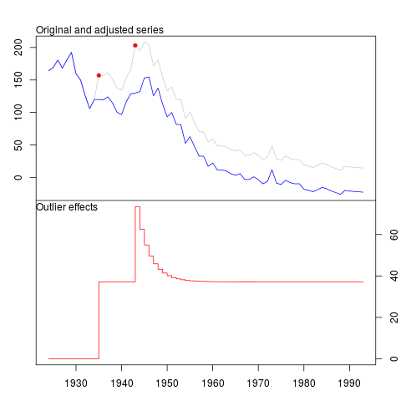
tsoutliers package
Pros:
Formalism
Integration with (S)ARIMA
Cons:
Speed? (+12h on BAOL033X_C6550.csv)
Ad-hoc (messy) solution
ToDo:
Simulations for validation
Visualization of AO, LS en TC outliers
Think it best works with “all” outliers enabled.
Notes:
Zou best

Slide 127
anomalize package

Slide 128
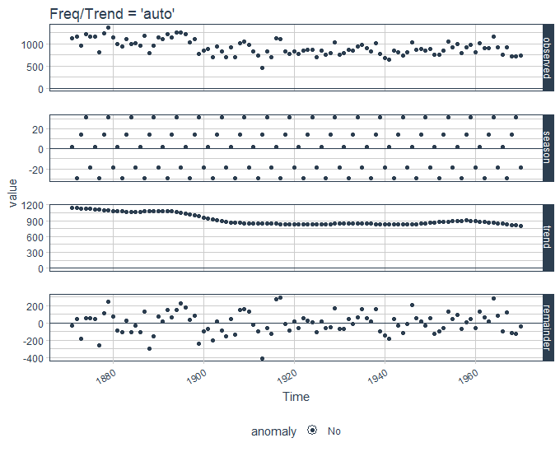
anomalize package
vs. tsoutliers
Notes:
Same Nile dataset

Slide 129
anomalize package
Pros:
Straightforward and fast timeseries decomposition
Cons:
Only AO
LS and TC can not be specified
Not backed by decent theory
Notes:
Zou best

Slide 130
gwloggeR
Feedback?

Slide 131
Next steps

Slide 132
Next steps
Define control vocabulary?
Suggested function output:
?
Notes:
temporal change : multiple points after the change should be “red”
Level shifts: how to flag those?

Slide 133
Next steps
Go further with tsoutliers
Visualisation: level shift (LS)
Simulations
Give a better idea of model performance for specific cases
Examples:
ARIMA(0,0,0) with AO
ARIMA(0,0,0) with LS
etc.
gwloggeR versioning?
Notes:
temporal change : multiple points after the change should be “red”
Level shifts: how to flag those?

Slide 134
The End

Slide 135
Sprint 1
Outliers

Slide 136
Outliers
v0.01: detect_outliers(data)
Uses only the supplied dataset
v0.02: detect_outliers(data, type = c(“air pressure”, “air temperature”), units)
Uses simple a-priori knowledge about air pressure, temperature, etc.
v0.03: …

Slide 137
Outliers: v0.01
Uses only the supplied dataset

Slide 138
Outliers: v0.01
Validation

Slide 139
Outliers: v0.01
Validation

Slide 140
Outliers: v0.01
Validation

Slide 141
Outliers: v0.01
Validation

Slide 142
Outliers: v0.01
Validation

Slide 143
Outliers: v0.01
Validation

Slide 144
Outliers: v0.01
Validation

Slide 145
Outliers: v0.01
Validation
Scale completely wrong?

Slide 146
Outliers: v0.02
Uses simple a-priori knowledge about air pressure, temperature, etc.

Slide 147
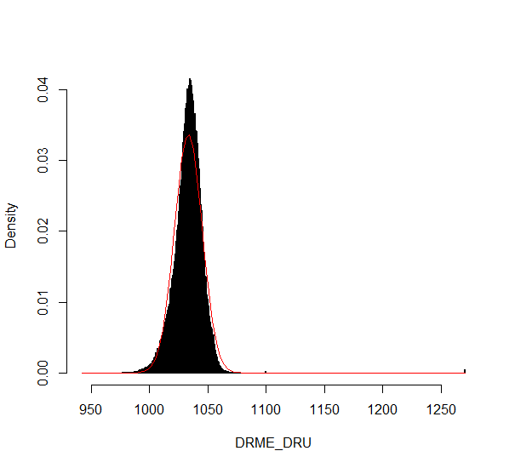
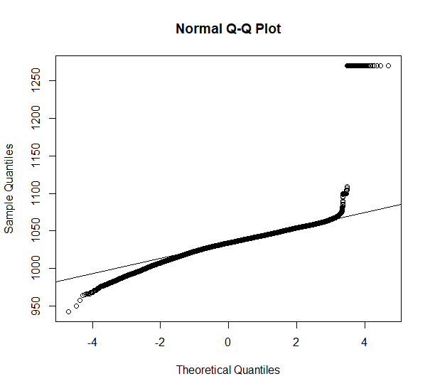
Outliers: v0.02
Validation

Slide 148
Outliers: v0.02
Validation

Slide 149
Outliers: v0.02
Validation

Slide 150
Outliers: v0.02
Validation

Slide 151
Summary
Outliers: v0.01
detect_outliers(data)
Usable on any data (not only L - lucht)
Scale can be completely wrong (cf. BAOL018X_42112)
Outliers: v0.02:
detect_outliers(data, type = c(“air pressure”, “air temperature”), units)
Needs a-priori information
Type
Units
Fixed or dynamic thresholds?
Notes:
Tresholds voor outliers kunnen berekend worden op basis van handmatige prior analyse, of

Slide 152
Outliers: v0.03
Go even further with a-priori information?

Slide 153
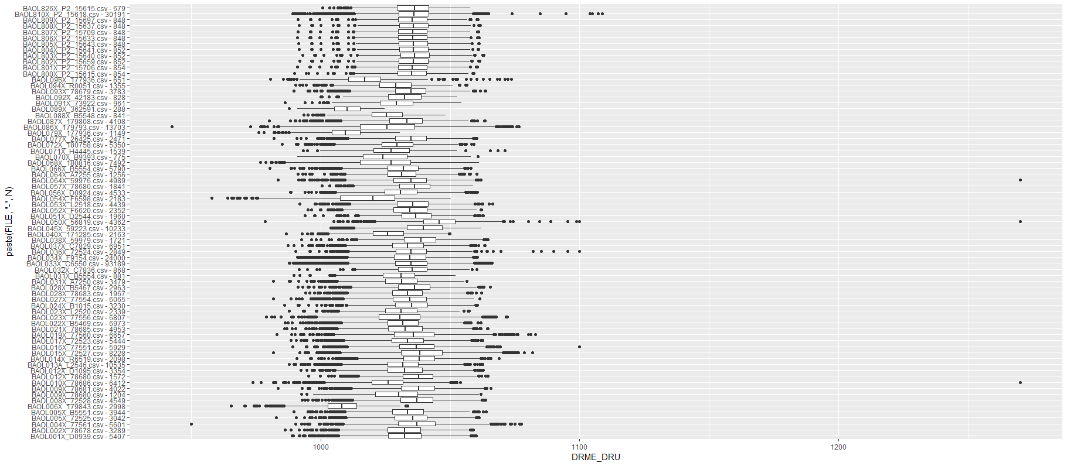
Outliers: v0.03
Even more a-priori information to explain variation
Notes:
Bijvoorbeeld, somige regio’s hebben lagere of hogere temperature, wat resulteert in hogere of lagere luchtdruk.

Slide 154
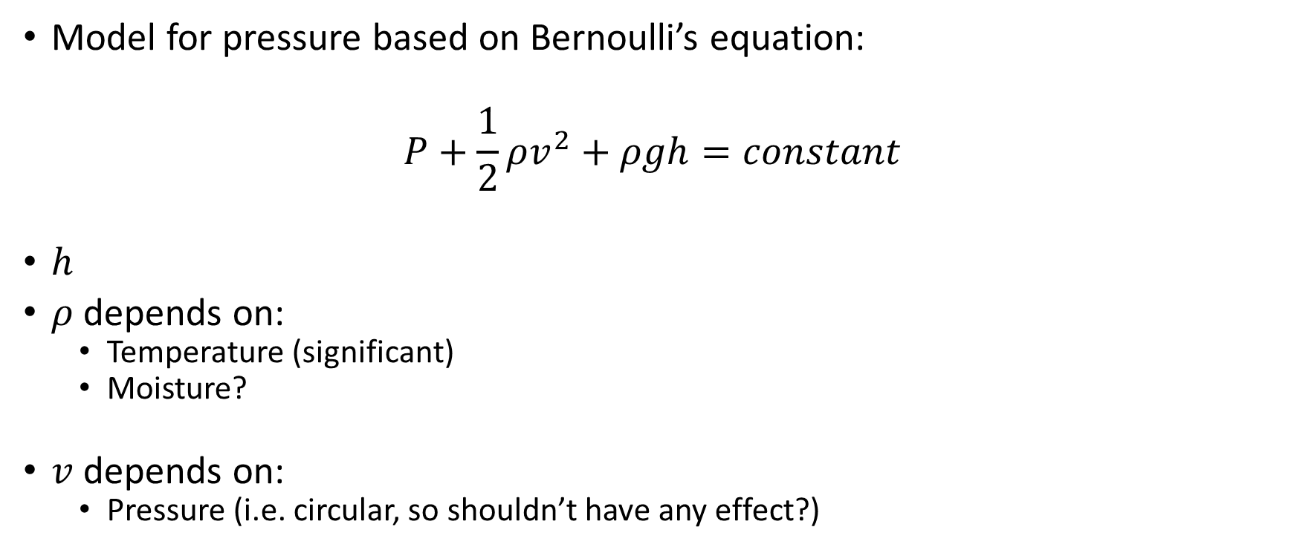
Outliers: v0.03
Model for pressure based on Bernoulli’s equation:
$$P+\frac{1}{2}ρv^{2}+ρgh=constant$$
$h$
$ρ$ depends on:
Temperature (significant)
Moisture?
$v$ depends on:
Pressure (i.e. circular, so shouldn’t have any effect?)

Slide 155
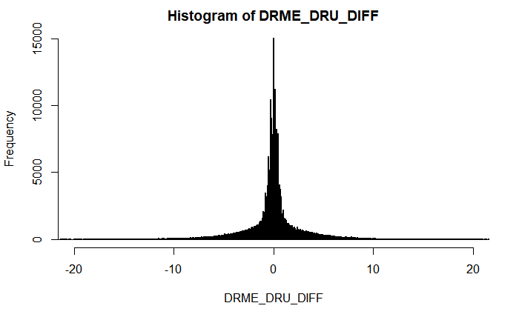
Outliers: v???
First order difference: very long tails
Notes:
Very long tails, not normal

Slide 156
Next steps

Slide 157
Next steps
Make first version of package with outlier detector 0.01 and 0.02?
If no extra data supplied, use v0.01, else v0.02?
v0.02: fixed or dynamic thresholds?
Other ideas?
Notes:
Misschien best om zo snel mogelijk met package te beginnen: dan kan gebruik meteen geevalueerd worden.

Slide 158
The End

